Slide 1


PRESENTED BY
SUBHAJIT GHOSH Roll: 10000220058 Reg.:20100010022005
JOTIRMAY SIKDAR Roll:10000220060 Reg.:201000100220007
RAJIB KUMAR MAJUMDER Roll: 10000219024 Reg.: 030957
SAPTARSHI MONDAL Roll: 10000219074 Reg.: 043001
PROVIDING DATA PRIVACY OF E- HEATHCARE DATA
BTech in Information Technology
Guided By :-
SAYANTANI SAHA
Department of Information Technology.
Maulana Abul Kalam Azad University Technology, West Bengal, India

Slide 2
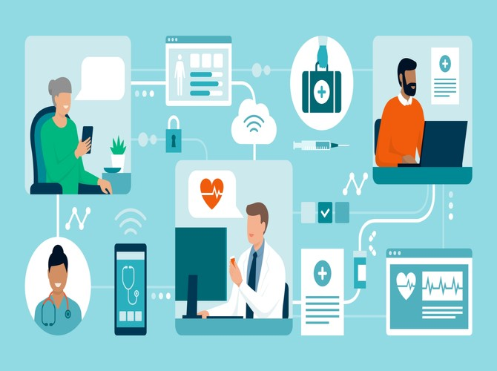
Motivation
We chose this project because working in healthcare will allow us to reach our aspirations to help others, earning a wage in the meantime.
We can help bring a new life to the earth or save another life from ending. Working in healthcare, directly or indirectly to another person, we will be changing lives and impacting families.

Slide 3
Literature Review
Digital health has the potential to prevent disease and lower healthcare costs, while helping patients monitor and manage chronic conditions.
It can also tailor medicine for individual patients & healthcare providers also can benefit from advances in digital health.
Digital tools give healthcare providers an extensive view of patient health by significantly increasing access to health data and giving patients greater control over their health. The result is increased efficiency and improved medical outcomes.

Slide 4
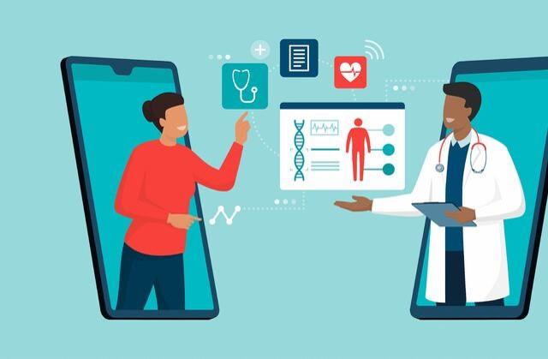




PROPOSED METHOD: To collect most of the information about hospitality and medical services: • Patients are easily allocated to the doctors. • Doctors search and pharmacy search is possible.

Slide 5
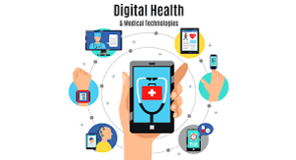
IN FUTURE
In future we will be using block chain technical skills for data privacy. As a example we say that if a patient admit in a hospital for his diseases .
There the doctor and register admin have some question for him .and its recorded by authority and its store a data base. And second one is the same patient is admit another hospital for another disease .Here the previous hospital does not share the information of the patient with the second hospital.
Here is information blockage and data corrupt. Only the doctor , admin and the patient access the data. The pharmacist will not access the data .He just access the prescription. Only the patient have the main access to share the data with the another hospital.

Slide 6
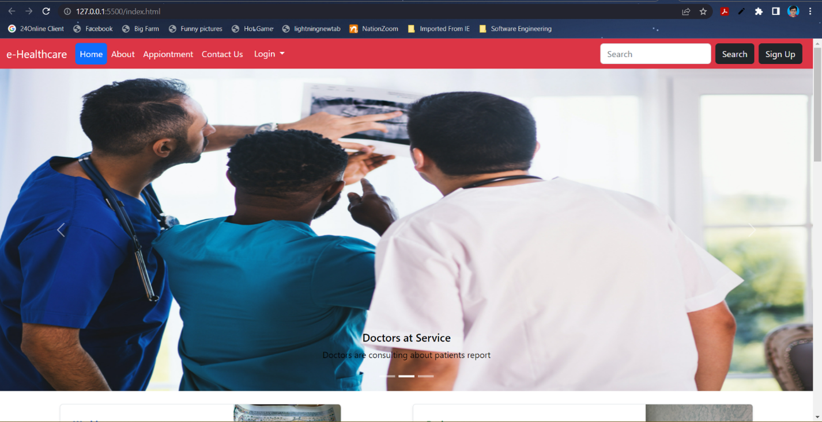
Front End

Slide 7
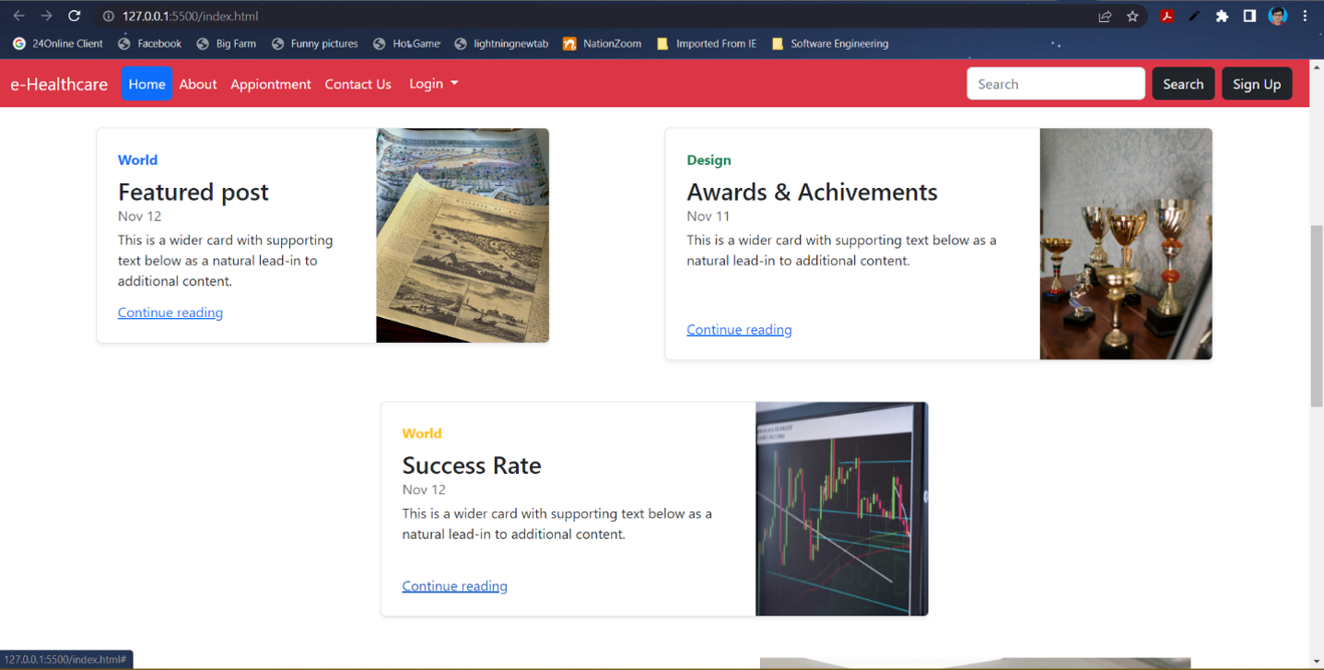

Slide 8
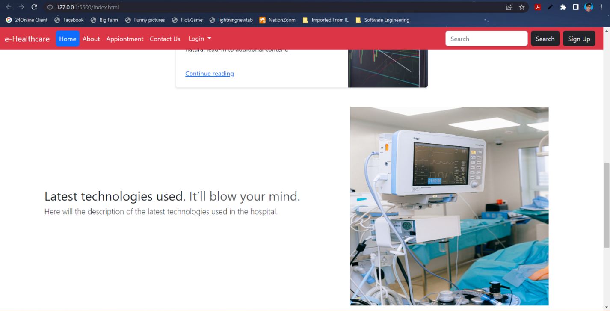

Slide 9
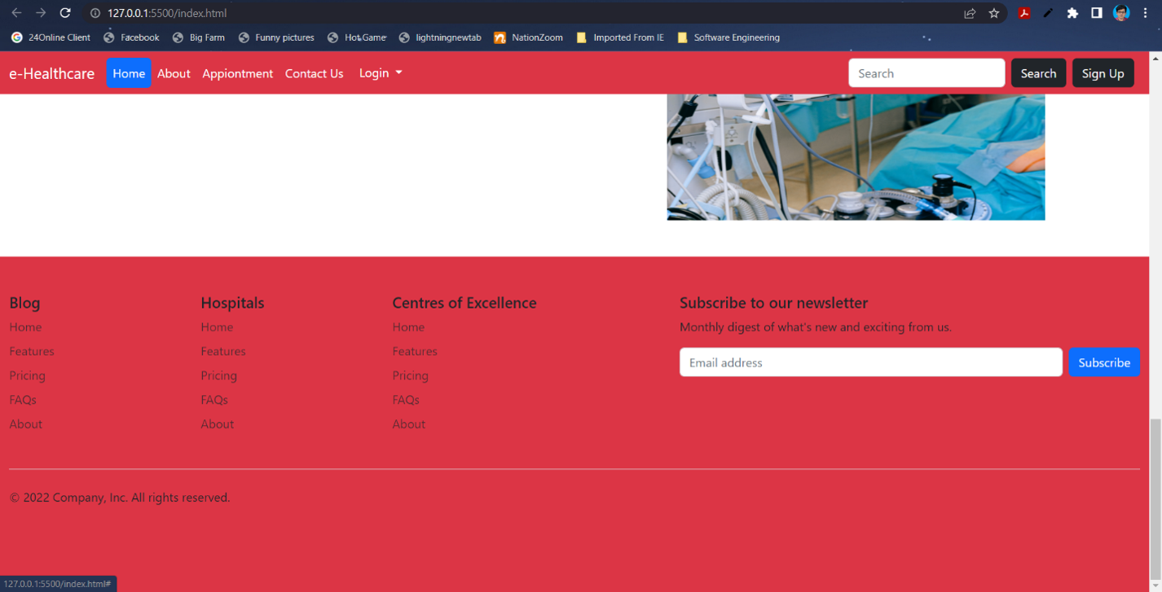

Slide 10
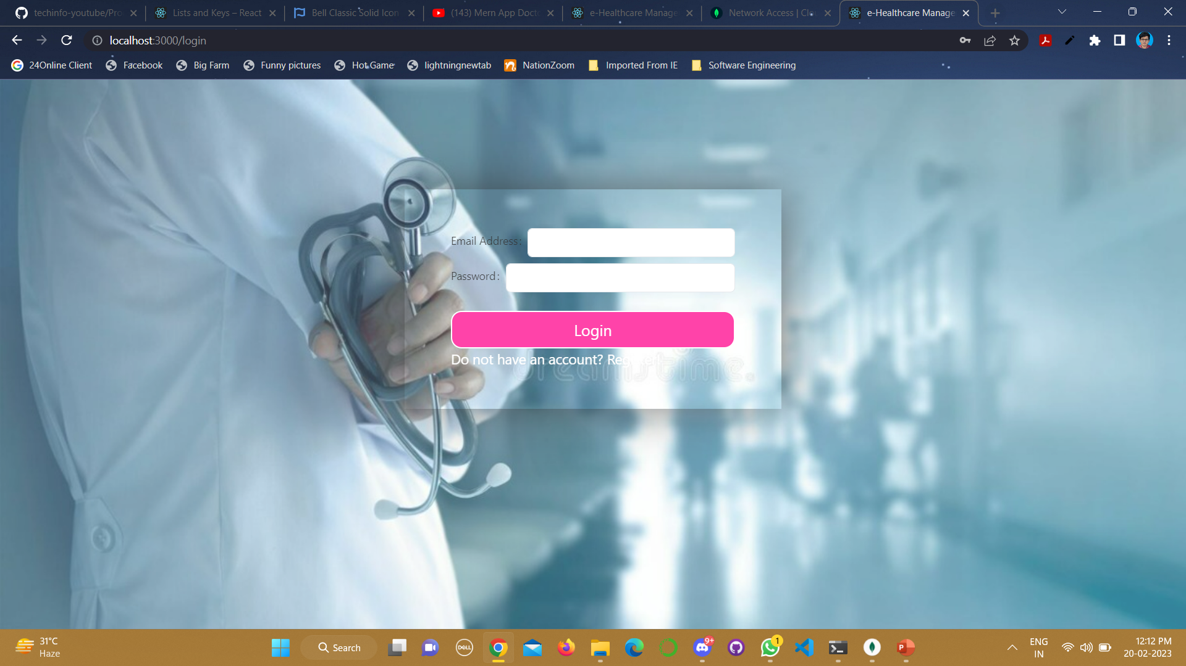

Slide 11
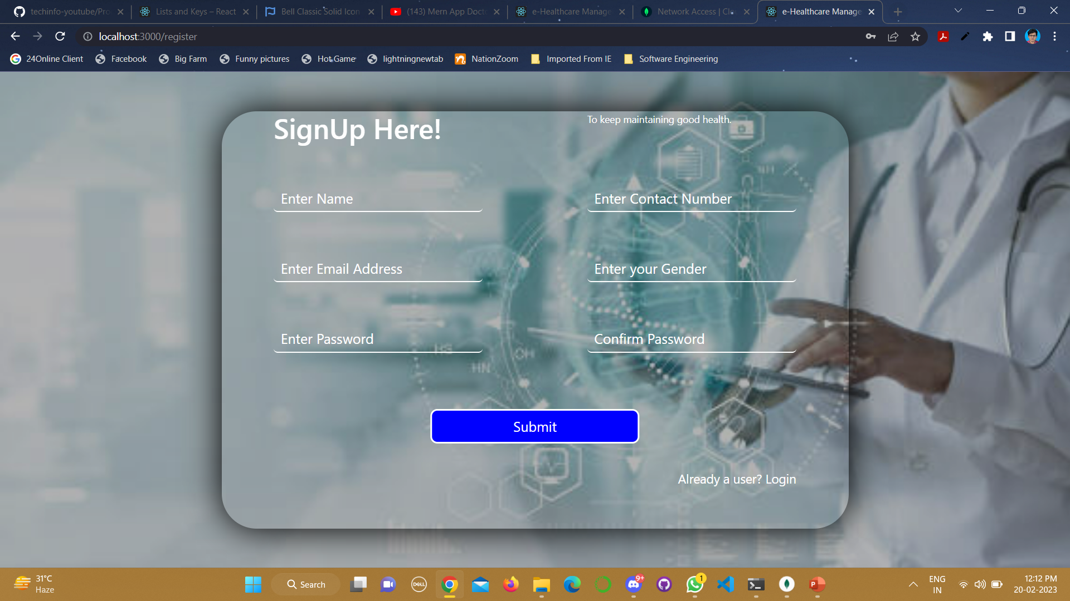

Slide 12
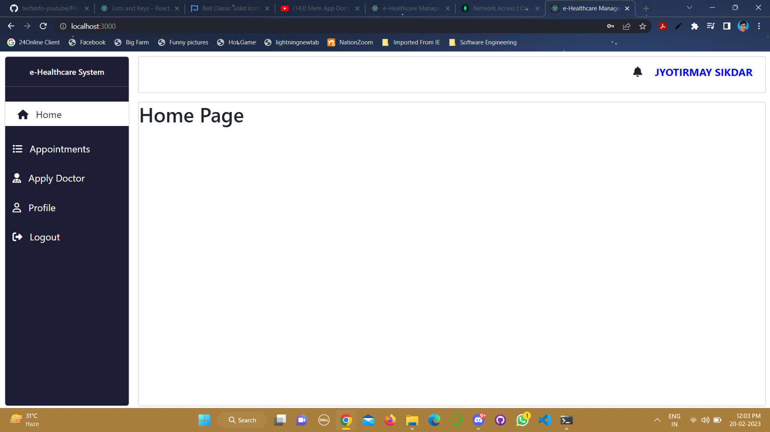

Slide 13


Slide 14
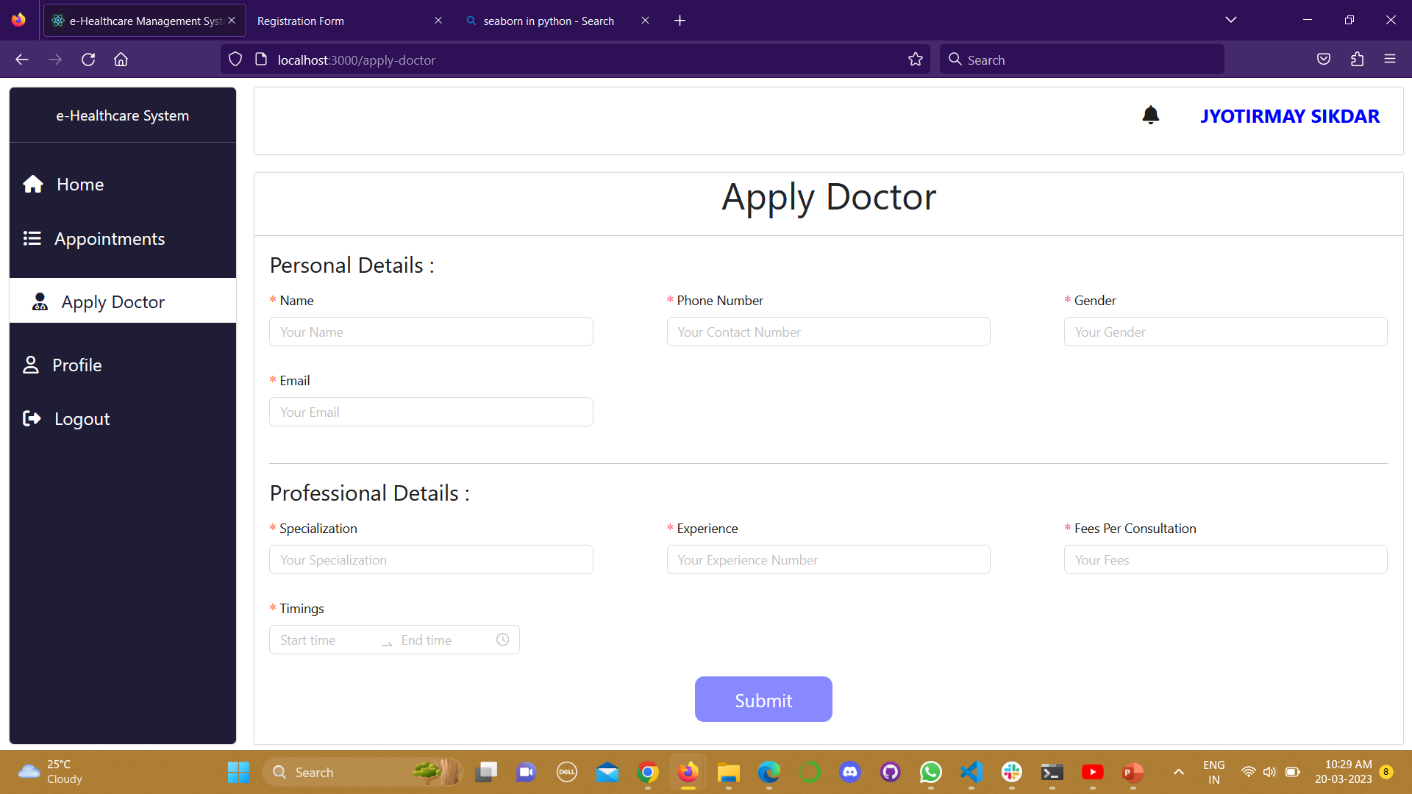

Slide 15
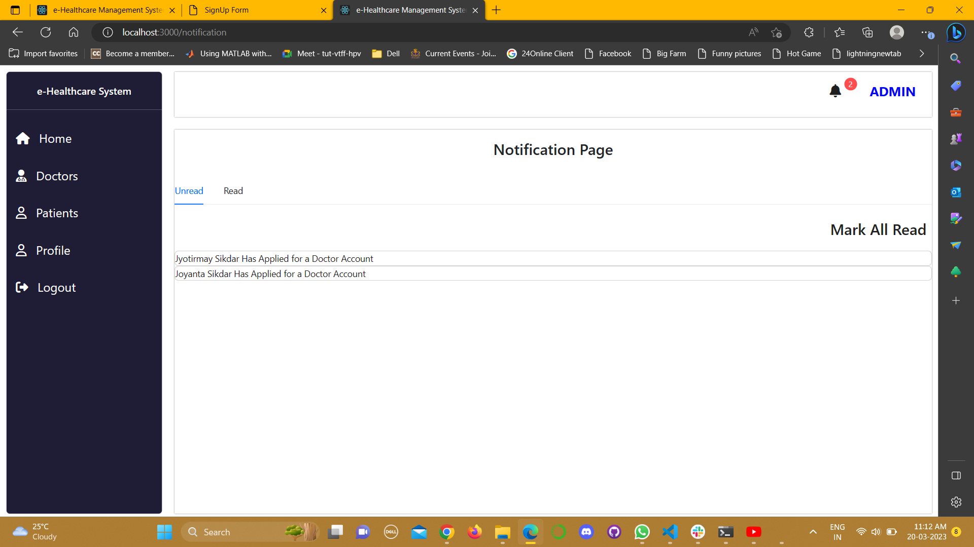

Slide 16
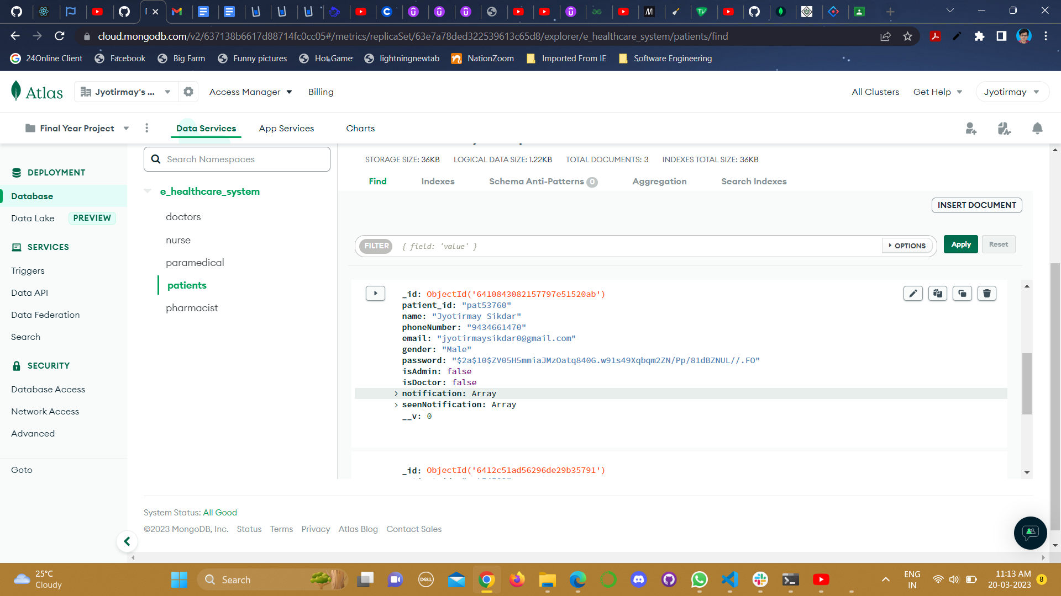

Slide 17
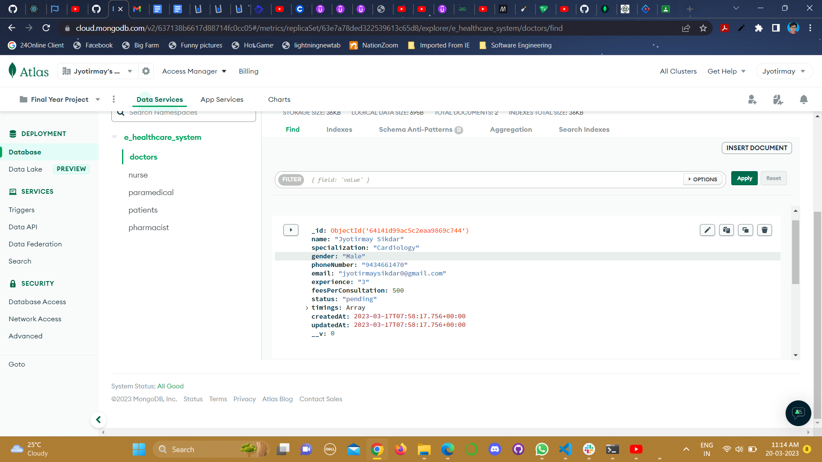

Slide 18
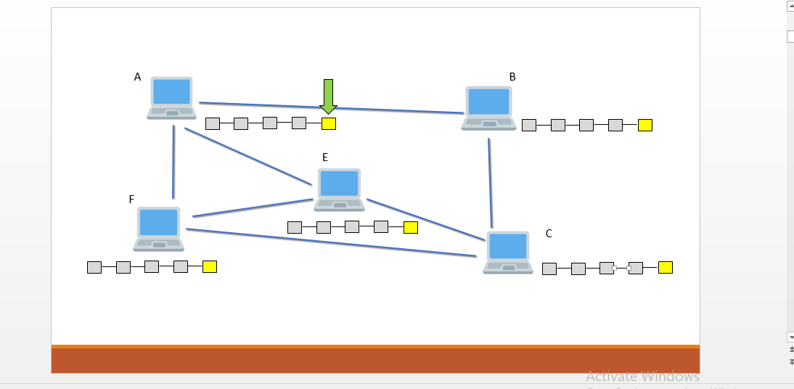

Slide 19
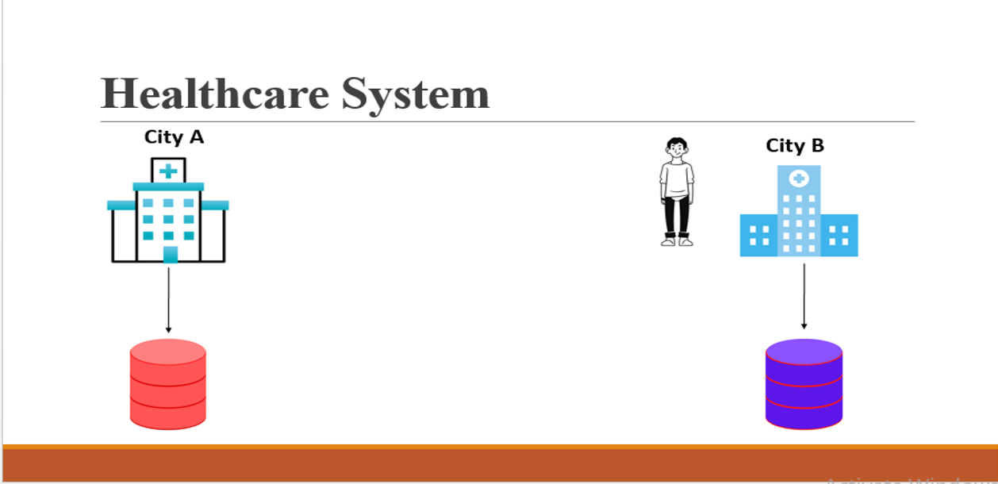

Slide 20
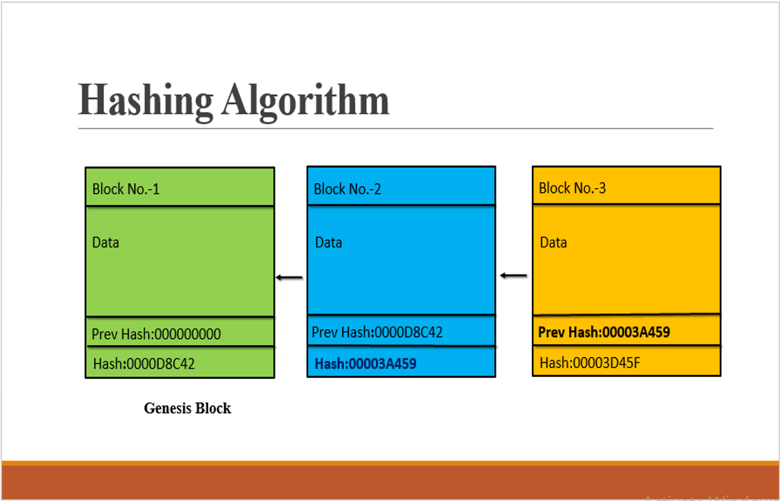

Slide 21
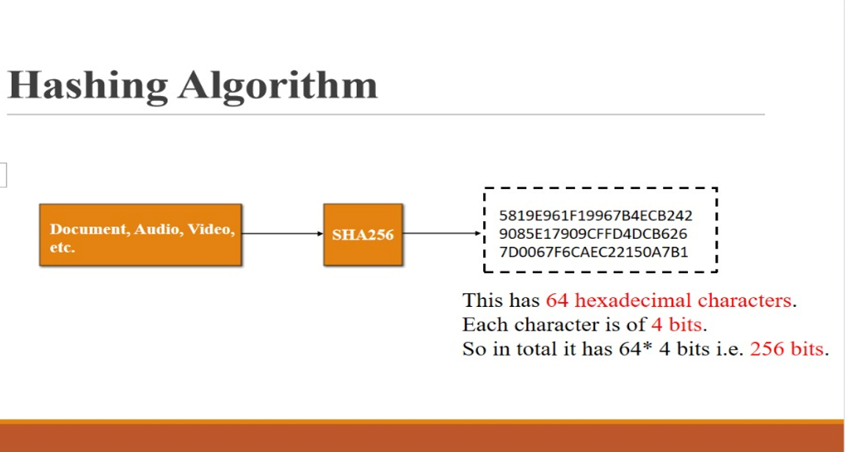

Slide 22
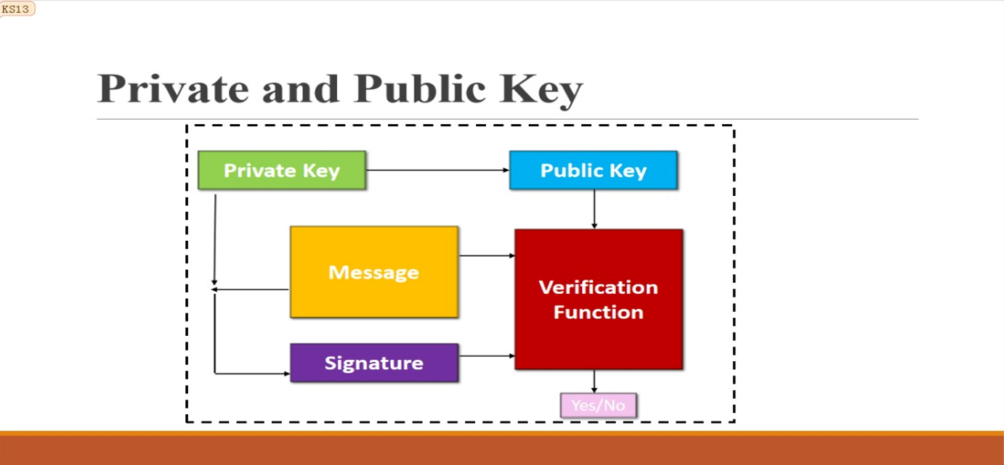

Slide 23
Conclusion
E-Health in the home is a potent, powerful and rich technology that offers significant benefits for many stakeholders.
We need to be sure, however, that when embracing this technology the elderly patient is not simply seen as another component in the "system“.
Individual patient needs and views regarding homecare and their health, safety, dignity, respect and fears must be listened to. With some limited exceptions, others cannot make assumptions in this personal and sensitive area.

Slide 24

Thank You!

